Slide 1
Why your ERP is NOT delivering and how to fix IT
James A Robertson and Associates
Effective Strategic Business Solutions
5. How to fix your ERP
The Real Issues in World Class ERP and the Critical Factors for ERP Investment Success
Dr James Robertson PrEng
Copyright 2004 through 2013
James@JamesARobertson.com
Notes:
NB remember to have a chair to stand on
Make sure to take the CRITICAL FACTORS BOOK with you
An engineer with a PhD in engineering

Slide 2
Discussion
How will you fix your ERP?
Notes:
DHL, Prochem,

Slide 3
Factors causing ERP failure
Prevent failure

Slide 4
Factors for ERP reimplementation success

Slide 5
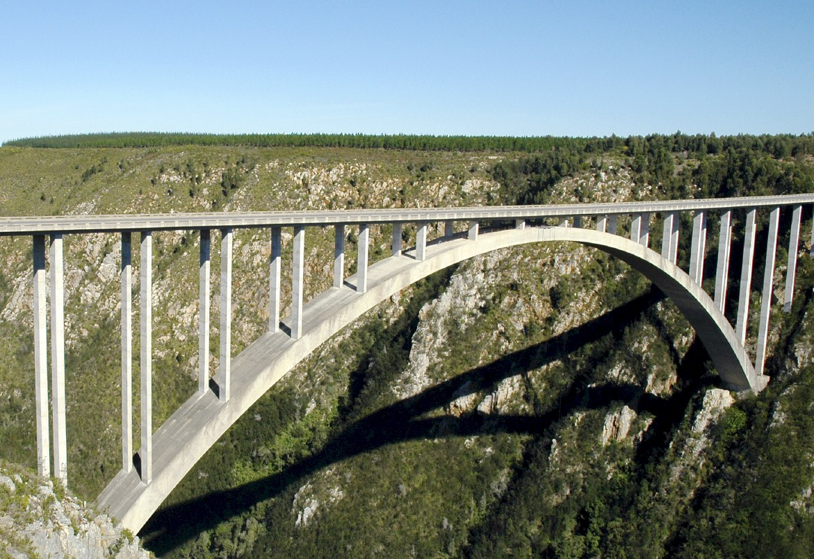
Engineers design bridges NOT to fall down
R e c a p
Notes:
There is a fundamental difference in approach when one designs a bridge NOT TO FALL DOWN
Contrast this with the IT paradigm which could be called “designed to fail”

Slide 6
Critical issues approach
Focus on the critical issues
Risk based estimating

Slide 7
Analysis of findings at ...
Conclusions
Nothing wrong with … -- work on a 20 year design life
Severe risk of fatal business damage
Huge opportunity for strategic high value implementation
Recommend route – precision strategic engineered configuration based configuration and implementation using:
Strategically focused,
Top down
Fundamental first principles,
Precision,
Hierarchy,
Structured codes,
etc
Notes:
DHL, Prochem,

Slide 8
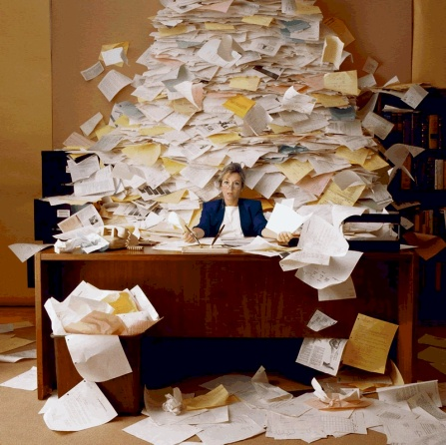
Data engineering
Notes:
DHL, Prochem,

Slide 9
Data engineering principles
Case study
E.R.P. Dramatic increase in management information
Reduction in head count
Dramatic reduction in audit time and cost
Unqualified balance sheet first time in 15 years
Presented with the client at a public conference

Slide 10
Characteristics of a successful team
Multi-disciplinary, etc
1. Design against failure -- constantly top of mind – 22%
2. Know and apply the critical factors for success, manage against the factors causing failure, manage principles for success, stages, critical human foundation, etc -- 20%
3. Strategy is the foundation on which the solution is built – strategic leadership, right things well, coupled to CEO leadership – custodian of the integrated vision -- 18%
Change facilitation and other soft issue services, competence modeling, psychometrics, etc -- 14%

Slide 11
Characteristics of a successful team
Multi-disciplinary, etc
5. Data engineering, cubic business model as basis for integration, associated software and code maintenance services -- 12%
6. People -- critical issues methods, disciplines, engineering rigour, multi-disciplinary, hard and soft components, high focus, high energy, motivated, loyal, quick attack approach -- 10%
7. Standards, documented methods, tools, standard operating procedures, reference documents, standard practices, policies, etc -- 4%

Slide 12
Guiding principles
Engineer solutions not to fail
Assist clients to do the right things well – thrive
Very long solution lives -- right to maintain and repair
Strategic, top down, fundamental first principles solution design – critical issues
Content is critical – the content NOT the technology
High effectiveness and efficiency –

Slide 13
Coding
Fundamental first principles analysis of all possible data
Major categories correspond to essence of how we run the business
Multi-level structured hierarchy
Structured code scheme
Accurately translate human understanding into machine readable codes
Notes:
Undertake a fundamental first principles analysis of all the data that we require in the Item Master
Create major categories that correspond to the essence of the way we run the business
Progressively develop a multi-level structured hierarchy that reflects the way we run the business and want to report on these items
Develop a structured code scheme that accurately translates human understanding into machine readable codes that result in the codes accurately reflecting real world reality

Slide 14
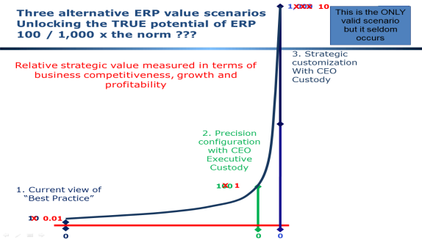
Some SMALL things YOU can do
To make your ERP work better for you TOMORROW
Repopulate key standard attribute tables
Create new custom attribute tables

Slide 15
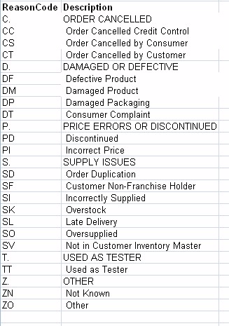
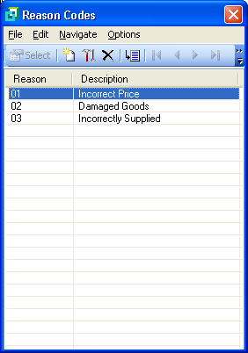
Repopulate key standard attribute tables
Example of poor credit note reason codes – actual case
Strategically aligned credit note reason codes
Drastically improve the content of some key tables such as Credit Note Reasons, Product / Item Class, etc

Slide 16
Develop lists
One to ten people in a room with a projector
Brainstorm all possible content for the list – capture on screen
Each summarize to between five and ten headings
Type all the lists in
Combine them into between five and ten groups
Give each group a heading
Lift out sub-categories
Code – remember indents, trailing periods, capitalization
Check impacts
Implement

Slide 17
Develop lists 2
Quality of list is dependent on quality of input
Want lists to be complete, comprehensive and well designed
Design compromises will be with you for ever
Document
Train
Utilize

Slide 18
Develop lists 3
Develop Hierarchy
Hierarchy of descriptions – indent each level by one character position
HEADINGS IN CAPITAL LETTERS
Posting level items in Proper Case
Abbreviate as necessary
Code
Mirror indents with trailing periods
Gap code
Mnemonic Alpha preferred, else Alpha Numeric, else Numeric
1 to 4 character segments separated by “-”

Slide 19
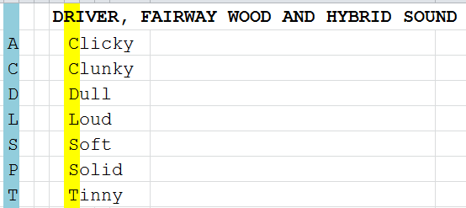
Create new custom attribute tables
Add user defined attribute fields anywhere where they make sense – Products, Debtors (Customers), etc

Slide 20
Develop attributes
One to ten people in a room with a projector
Brainstorm all possible attributes for management information
If in doubt add
Structure and Code as before
Capture sheets
Train staff to classify and add
Reports
Identify clever functionality that can work with attributes, add where cost effective
Harvest information

Slide 21
Unlocking the full potential
Progressively improve classifications and add attributes
Progressively develop reports, analysis and custom functionality
Advance to more complex and inter-related lists:
Product / Item / Material Class / Group is the largest list that you might apply this approach to
Major Master Lists like Chart of Accounts and Product Catalogue / Master might be done in increments ONCE you have experience with this approach
Other Master Lists like Debtors and Creditors Masters could be restructured in time
Eventually you might find you have effectively re-implemented

Slide 22
10 things to look out for
Ambiguous names, incorrect postings – ANSWER – change the name so that it is unambiguous – e.g. Factory -- Operating Cost and Factory – Asset
Jumbled accounts and other lists – ANSWER –new sub-structure
Large number of dissimilar transactions in one account having to unscramble in Excel – ANSWER – create a block of well thought out accounts to replace the single account
Overlapping or duplicate entries – e.g. same Tyres in different places – ANSWER – close duplicates, only one set of entries – may close both and open a new set of well-structured entries
Answers to “common sense” questions take ages to obtain – lots of analysis in Excel or custom software that keeps changing – check if all the common sense attributes are on the master record and add as necessary – as many as possible – once you start adding do the lot

Slide 23
10 things to look out for
Evaluate all manual, spreadsheet and custom applications and determine where these are a response to inexact or sloppy configuration and progressively adjust or eliminate.
Develop a comprehensive awareness of the need for accurate data, train personnel in terms of neatness, accuracy, spelling, capitalization, accuracy of allocation, etc
Develop soft-issue metrics – customer satisfaction, employee satisfaction, etc
Harmonize critical elements of information classification – Accounts, Assets, People, Products – across all modules and all systems – develop an integrated environment, especially between the ERP and the Operational Systems
Balance the decision support load between modules – move the detail out of the General Ledger – 5 to 10 Asset Categories, People Categories, Inventory Categories, etc

Slide 24
Coding
Analyze all the parameters and attributes
Add additional fields (columns) as necessary
Custom software to facilitate and enforce standards
Part time Information Manager (B degree)
Notes:
Analyze all the parameters and attributes that associate business knowledge and intelligence with each item and structure these codes and logic
Add additional fields (columns) to the item master table if necessary to classify items for Fraser Alexander’s unique requirements
Specify custom software that encapsulates the logic of the coding scheme, business rules around the scheme, default attributes at each level of the hierarchy and other facilities to ensure high precision in adding item codes
Appoint a part time Information Manager with a professional qualification to exercise quality control over the data

Slide 25
Processes – current status
Standards NOT currently embedded
Every division does things differently
Divisions do things the opposite way and both ascribe to auditors
Every operator does things differently
New staff receive minimum training, thrown in deep end
Notes:
Process standardization is non existent and processes are not well thought out
The work done five years ago was never embedded and has been almost entirely lost
Contrast the socialisation and training that we do with operational staff with the lack of training of administrative staff

Slide 26
Process optimization
Collaboratively harmonize and develop group standards
Close consultation with divisions – escalate to MD’s where necessary
Embed through computer based training
Maintain consistent high standards
New staff
Acquisitions
Sustainable back office business efficiency
Notes:
This will be an ongoing culture and may be extended to process that have nothing to do with Movex over time
The project will be limited to those processes that relate to the core, high volume operation of Movex

Slide 27
Computer based training
Interactive, scored, progress monitored
Contract qualified educator and developer
Embed in culture of the Group
Train existing staff to high standards
Train new staff and acquisitions
Notes:
Reproducible standards
Efficiency
Ensure that we maintain the quality of the data and Movex operation on a long term basis

Slide 28
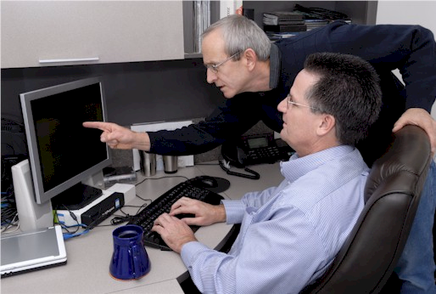
Laboratory
A location where the real world is precisely simulated on a statistically valid representative basis
ALL possible scenarios thoroughly tested
Notes:
DHL, Prochem,

Slide 29
Strategic alignment
Essence of why the business exists and how it thrives
Model the business in the configuration from a strategic perspective
Data engineering

Slide 30
Tough clients

Slide 31
The way forward
Business NOT ...
Focus on strategic capability and drive the implementation from this – structured critical issues analysis and design -- StratProc
Document strategic definition and align all activities strategically top down – precision fundamental first principles data engineering and configuration
Effective change facilitation
Comprehensive rigorous project run by professional team who are contractually accountable for their deliverables
Traditional approach will require 12 to 18 months, ... cannot afford that, intense high energy project 6 to 9 months
Design against failure critical issues approach

Slide 32
Context -- summing up
ERP Failure is rife – reasons for failure have been presented
ERP Failure can be prevented or rectified provided that:
Follow an engineering approach – design against failure, precision, accountability, etc
Strategic focus and alignment
Data engineering based configuration and system integration
Executive custody
Change facilitation
Notes:
DHL, Prochem,

Slide 33
Approach
Engineer against failure
Strategically aligned, top down, data engineering, etc
Make use of structure to drive report and dashboard generation
Accountability -- lawyer on the project team – contracting, etc -- availability of personnel guaranteed
Laboratory
Computer based training

Slide 34
Call to action
Three actions?
Defects are entirely preventable
ERP is NOT magic do NOT abdicate your intellect
Design AGAINST failure
You DO understand ERP
Slow ERP down to your speed!
Align ERP with the essence of your business (strategy)
CEO custody and leadership are critical– take charge

Slide 35
If you do not act within 48 hours you probably never will (Bill Gates)
Act TODAY! ☺
What is your single most important insight from this briefing?
What is the single most practical action that you can take tomorrow to apply E.R.P. more effectively?
Please write down your thoughts
NOW
James@JamesARobertson.com

Slide 36
Design ERP solutions like bridges ...
Not to fall down – intelligent content

Slide 37
Acknowledgements
Clients, associates, staff
Father and mother, Angus and Thelma
Children Alexandra and Struan
Other significant people in my life
Psalm 136:5 "To Him who by wisdom made the heavens, for His mercy endures forever;"

Slide 38
Questions?
Remember to design against failure!
Dr James Robertson PrEng
James A Robertson & Associates
Telephone: ++27-(0)86-111-5409
/ ++27-11- 782-5996/7
Cell: 083-251-6644 (preferred)
Fax: ++27-(0)86-540-0178
P O Box 4206, Randburg, 2125,
South Africa
www.JamesARobertson.com
email: James@JamesARobertson.com
Please remember to complete the evaluation forms
Please remember the discussion forum and workshop this afternoon

